Slide 1
Pet Game Concept
My very epic game idea C:

Slide 2
Overview
Virtual pet game where you raise a pet
Can feed and play with the pet to make them happy
Lots of different food and toy items in a shop
Way to earn coins to buy things by petting pet
Pet will grow up depending on care

Slide 3
Win/Lose States
Player keeps playing until their pet grows up or dies, then they get to try again
Win state: pet grows up successfully
Lose state: pet dies because YOU SUCK
Different care leads to different outcomes (replayability)
May be satisfying to see what all the pets look like

Slide 4
Scope
Not too many differing evolutions for pet to keep it simple
Have a way to advance time without needing to calculate real time (and for easier playtesting)
Keep art assets simple and only made as necessary
Priorities: base functionality, interesting pet behavior (moving over to food dropped on floor), ability to pet and bathe the pet

Slide 5
Implementation Strategies
Any food or toy, etc will derive from a consumable base class
Different states for pet in an enum like hungry, sad, neutral, full, and happy
Enums can also handle behavior states like idle and wandering
Script to handle pet evolution with pet prefabs as fields
Game manager, item manager, and UI manager objects

Slide 6
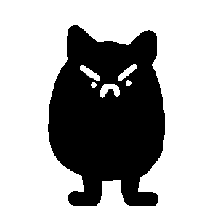


Pet Designs
Baby pet
Bad care teenager
Good care teenager

Slide 7





Gameplay Flowchart
Pet Moves Out
Care for baby pet
Pet Becomes Teen
Pet Becomes Adult
Pet Dies
Regular game flow
Lose condition
Win condition

